Slide 1
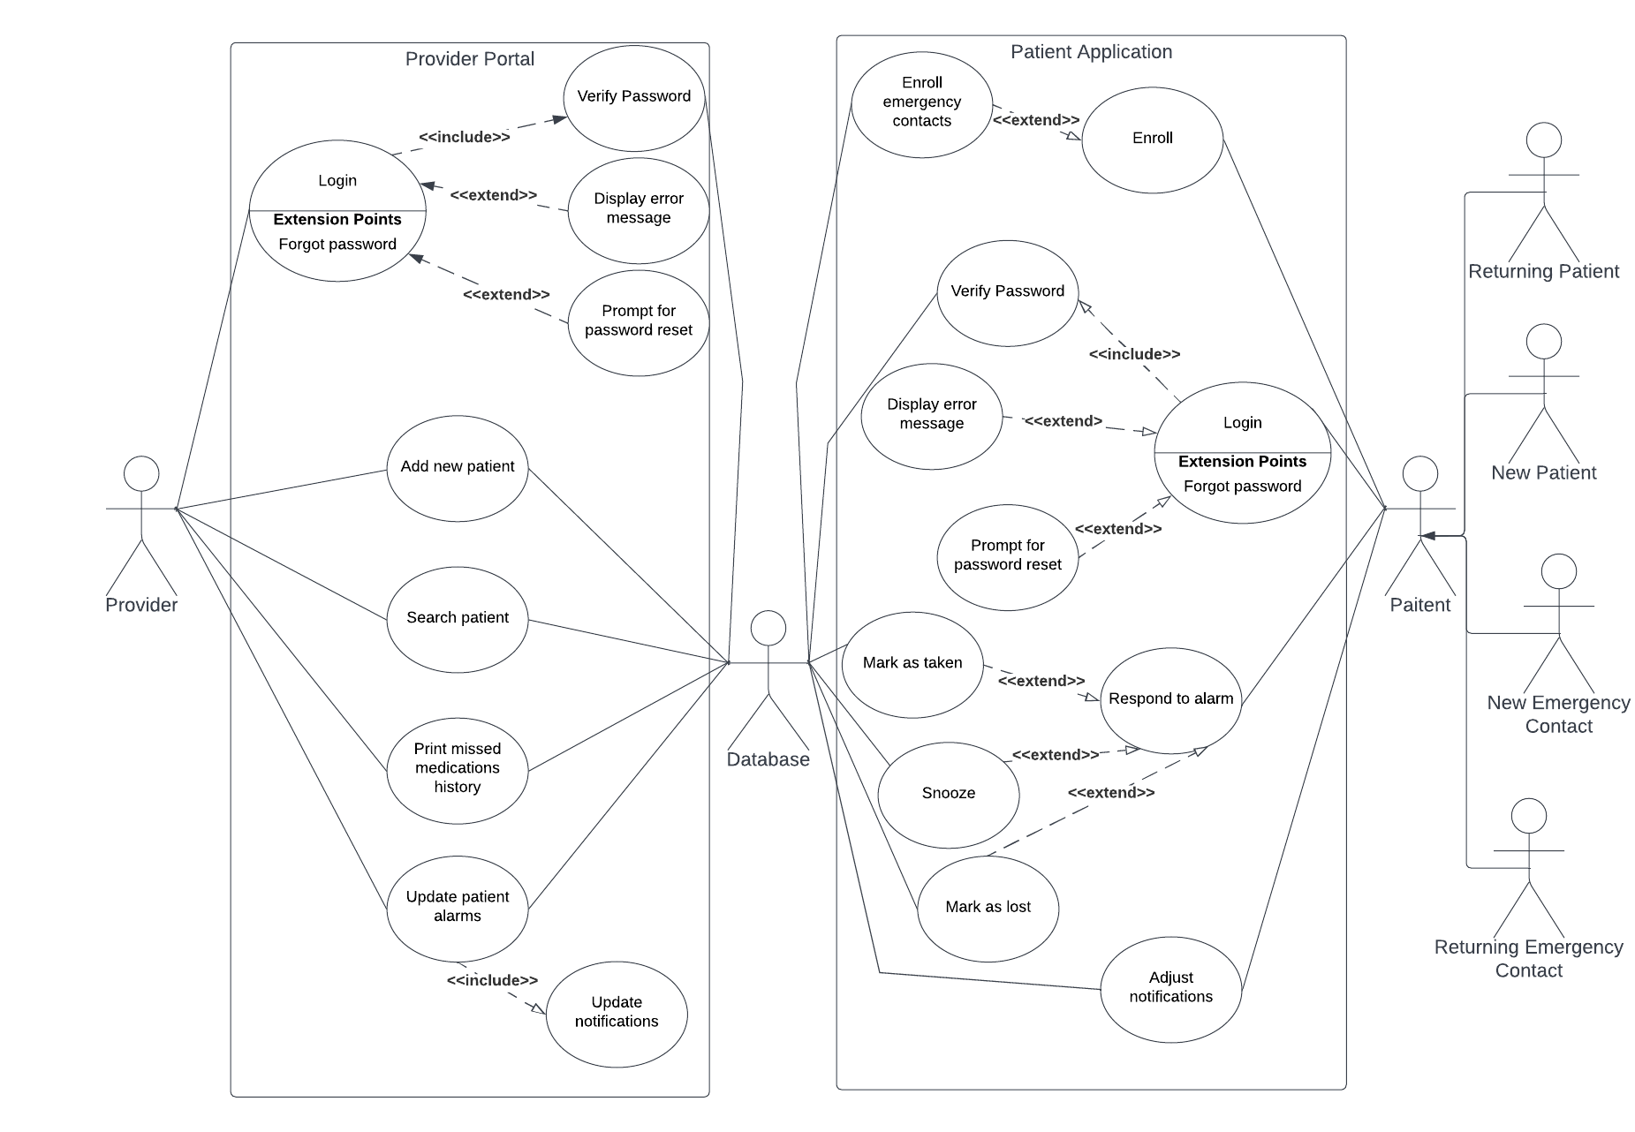
Notes:
Multiple pills at the same time?
Tell user emergency contact has been alerted?

Slide 2
Layered Architecture
User Interaction
How the Portal/Mobile alarm app look
Functionality
How they function based on business rules
Business Rules
Application Core
Database
"If patient missed alarm notify emergency contact and update report to Doctor"
Main programs and other components
Tables, indexes
Notes:
What else was available and seemed suitable:
Event-Drive architecture because it triggers a notification to be sent when an event happens like it being time to take your pills or missed the time to take your pills but seems too fragile, if the event bus fails everything fails which means people are missing alarms to take their pills
Why this:
It seems more structured and versatile, allow for better system customization and the layers are autonomous so if one layer fails and needs maintenance the others will still operate

